Slide 1

AHB TO APB BRIDGE VERIFICATION
Name : V. Bhargava
Batch : BPRN-10
Mail Id : varrabhargava123@gmail.com

Slide 2
OUTLINES
Introduction
AMBA Buses
AMBA Versions
AHB Bus
APB Bus
AHB to APB Bridge
Write and Read Transfers
UVM TB Architecture

Slide 3

Introduction
Bridge is an interface between IP ’s of two different Protocols.
Bridge Converts one standard interface signals to another standard interface signals.
Here, AHB to APB Bridge converts the AHB Bus transfers to equivalent APB Bus transfers.
Understand the AHB and APB Protocols to verify the AHB to APB Bridge.
A Protocol is a set of rules that define how communication or interaction should occur between different components or systems.
Types of Protocols
Network Protocols: TCP/IP , HTTP etc.,
Communication Protocols: SPI,I2C,UART,USART etc.,
Hardware Protocols: AHB,APB,AXI,PCI,CHI etc.,
Software Protocols : FTP,SMTP,IMAP etc.,
AHB and APB are Hardware Protocols that provides the interaction between components(such as memory ,buses or interfaces).

Slide 4
WHY BRIDGE only ?
Communication between hardware blocks can be achieved by using Interface or bus or interconnect or bridge.
BUS :
Bus is a standard Interface to connect Ip ‘s.
Bus can connect multiple devices in a system.
Bus can connect the multiple buses of same type.
exp : AXI Bus can connect to multiple AXI buses only.
Bus can connect the limited number of components or devices.
INTERCONNECT :
Interconnect is a junction between multiple masters and slaves within a chip or system, which enables fair data access between IP ‘s.
Interconnects and buses do not perform the Protocol conversion between standard interfaces.
Interconnects can overcome the limitations of bus, by connecting the multiple buses or devices of different type but within a system.
Interconnect itself does not support the protocol translation or conversion mechanism.
BRIDGE :
Bridge can connect different networks or segments.
Bridge can manage the data flow and Protocol translation between segments.
An Interconnect with bridge instantiation can perform Protocol conversions.

Slide 5
BUS (or) INTERCONNECT Selection
Q. When to use a bus or interconnect???
We can select a bus or interconnect based on some Criteria.
Criteria | Use a Bus | Use a Interconnect
System Complexity | Simple & limited number of components | Complex system with multiple cores/devices
Data Width | Low to Moderate | High Band Width & Heavy data operations
Communication Pattern | Sequential and single shared path | Multi-directional, Parallel communication
Scalability | Limited Scalability | High Scalability with multiple components
Component Compatibility | Same Protocol & Uniform Components | Supports various buses & Protocol Conversion ready with Bridge.

Slide 6
AMBA Buses
AMBA : Advanced Microcontroller Bus Architecture
AMBA is a set of interconnects specifications developed by ARM(Acorn RISC Machine) to facilitate the design and integration of components in SOC(System On Chip) Architectures.
AMBA is a standard for connecting various digital components within a chip, enabling efficient communication between processor , memory and Peripherals.
AMBA , created by ARM as an Standard interface for their microprocessors.
AMBA is very common in commercial SOC ‘s ( Qualcomm , Multimedia cellphone SOC).
Actually AMBA supports 3 standards:
1. APB (Advanced Peripheral Bus)
2. AHB (Advanced High-performance Bus)
3. AXI (Advanced eXtensible Interface)
AMBA specifications defines an on-chip communications standard for designing high-performance embedded microcontrollers.

Slide 7
AMBA Versions
AMBA has Five Versions as follows.
Version | Release Year | Key Features
AMBA 1.O | Early 1990 s | Foundation for bus architecture.
AMBA 2.O | 1999 | Introduced APB,AHB and AXI Protocols.
AMBA 3.O | 2005 | Enhanced AXI with QoS(Quality of Service) features
AMBA 4.O | 2010 | Introduced AXI4, AXI4_Lite , AXI4_Stream.
AMBA 5.O | 2018 | Introduced CHI(Coherent Hub Interface) for multi-core systems.

Slide 8
AMBA-AHB Bus
AHB : Advanced High-Performance Bus.
AMBA AHB bus is used for high-performance and high clock frequency system modules.
All the high performance IP s that are working at high clock frequencies will be connected to AHB Bus.
AHB bus is a back bone bus of the high performance system.
AHB supports Efficient connection of Processors and On-chip & Off-chip external interfaces.
AMBA AHB Bus Transfer
Bus Transfer or Bus Transaction refers to the process of transferring data over a shared communication bus between different devices or Components, such as processor, memory and other peripherals.
AHB Bus transfer typically includes two Phases
Address Phase :
The master bus ( the device initiating transfer) places the address of the target device or memory location of slave on to the bus indicating where data should read from or written to.
The Bus master sends a Command or Control signal to indicate the type of transfer ( either read or write).
2. Data Phase :
The actual data is transferred
For Reads : The data is provided by the target/slave and sent to the master
For Writes: The data comes from the Master and is sent to the Target/Slave.

Slide 9
AHB Bus
AHB Transfer may take One or Two bus cycles.
Bus transfer is completed /terminated by a completion response from the addressed slave.
Transfer size supported by the AMBA AHB include byte ( 8-bit), half word(16-bit) and word(32-bit).
It also supports wider data transfer include: 64-bit transfer and 128-bit transfer.
It supports Burst transfer, means transferring a sequence of data(multiple words or bytes)in a single transfer.
AHB defines different burst lengths and type of bursts with HBURST signal.
AHB supports Pipelining Operation, means address and control phase for subsequent transfers can overlap with the data phase of current transfer.
AHB supports the Split transactions i.e., address and data phases
1st cycle: Address Phase – address & control signals
2nd cycle: Data Phase – Actual data will write to or read from the slave.
Single cycle bus master handover – The switching between different masters will happen in a single bus cycle.
Single clock edge operation – read or write operation will takes place at the single clock edge only.
AHB Complex Bus
Larger overhead - ~27 control signals.
Up to 15 masters allowed.
Split transaction Phases : Address and Data Phases.
AHB supports the limitations of APB i.e., Multi-master ,multiple outstanding transactions and back-to-back transactions.
Because of all these features , Unfortunately this adds significant complexity.

Slide 10
AMBA- APB Bus
APB : Advanced Peripheral Bus
The AMBA APB is for low-power peripherals.
AMBA APB is optimized for minimal power consumption.
APB reduces the complexity in interfaces to support peripheral functions.
APB Bus Transfer
APB is designed for Simpler , lower-speed peripherals do not require high bandwidth of AHB, such as UARTs , GPIO and timers.
It supports three phase transfer
->Idle Phase
-> Set up phase
-> Enable Phase/ Access Phase
An APB bus transfer is also a read or write operation of a data object.
APB Transfer always requires 2 bus cycles.
Transfer size supported by AMBA APB includes
->8-bit transfer
->16-bit transfer
-> 32-bit transfer

Slide 11
Differences between AHB and APB buses
Feature | AHB | APB
Purpose | High- Performance Peripherals | Low-speed Peripherals
Operation | Read or Write | Read or Write
Clock cycles | 1 or 2 clock cycles | Always 2 clock cycles
Transfer size | 8-bit , 16-bit, 32-bit, 64-bit, 128-bit | 8-bit , 16-bit, 32-bit
Pipelining | yes | no
Burst transfers | supported | not supported
Power Consumption | Higher due to complexity | lower due to simplicity
Transfer speed | Higher speed, suitable for memory | Low speed, ideal for peripherals

Slide 12
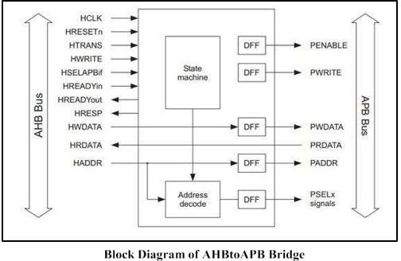
AHB to APB Bridge

Slide 13
AHB Signal Description
Name | Source | Description
HCLK | Clock Source | This Clock times all bus transfers. All signal timings are related to the HCLK.
HRESETn | Reset Controller | The bus reset signal is active LOW and is used to reset the system and the bus. This is the only active LOW signal.
HADDR[31:0] | Master | The 32-bit system address bus.
HTRANS[1:0] | Master | Indicates the type of the current transfer, which can be IDEAL, BUSY, NON-SEQUENTIAL and SEQUENTIAL.
HWRITE | Master | When HIGH, indicates WRITE Transfer. When LOW, indicates READ Transfer.
HSIZE[2:0] | Master | Indicates the size of the transfer, which is typically byte(8-bit), half-word(16-bit) or word (32-bit). The protocol allows for larger transfer sizes up to a maximum of 1024 bits.
HBURST[2:0] | Master | Indicates if the transfer forms part of a burst. 4,8 and 16 beat bursts are supported and the type of burst may be either increment or wrapping.
HWDATA[31:0] | Master | The Write data bus is used to transfer data from the master to the bus slaves during operations. A minimum data bus width of 32-bits is recommended.

Slide 14
AHB Signal Description
Name | Source | Description
HSELx | Decoder | Each AHB Slave has its own slave select signal and this signal indicates that the current transfer is intended for the selected slave. This signal is simply a combinational decode of the address bus.
HRDATA[31:0] | Slave | The read data bus is used to transfer data from bus slaves to the bus master during read operations. A minimum data bus width of 32-bits is recommended.
HREADY | Slave | When HIGH the HREADY signal indicates that a transfer has finished on the bus. The signal may be driven to LOW to extend transfer. Note: Slaves on the bus require HREADY as both input and an output signal.
HRESP[1:0] | Slave | The transfer response provides additional information on the status of a transfer. 4 different responses are provided, OKAY, ERROR, RETRY and SPLIT.

Slide 15
HBURST[2:0]
HBURST[2:0] | Type of Transfer | Description
000 (0) | SINGLE | Single Transfer
001 (1) | INCR | Increment burst of unspecified length
010 (2) | WRAP4 | 4-beat wrapping burst
011 (3) | INCR4 | 4-beat increment burst
100 (4) | WRAP8 | 8-beat wrapping burst
101 (5) | INCR8 | 8-beat increment burst
110 (6) | WRAP16 | 16-bit wrapping burst
111 (7) | INCR16 | 16-bit increment burst

Slide 16
APB Signal Description
Name | Source | Description
PCLK | Clock Source | The rising edge of PCLK is used to time all transfers on the APB.
PADDR[31:0] | Master | This is the APB address bus , which may be up to 32-bits wide and is driven by the peripheral bus bridge unit.
PSELx | Decoder | A Signal from the Secondary decoder. Within the Peripheral bus bridge unit, to each peripheral bus slave x. This signal indicates that the slave device is selected, and a data transfer is required. There is a PSELx for each bus slave.
PENABLE | Master | This strobe signal is used to time all accesses on the peripheral bus. The enable signal is used to indicate the second cycle of an APB transfer. The rising edge to PENABLE occurs in the middle of the APB Transfer.
PWRITE | Master | When HIGH this signal indicates an APB write access and when LOW a read access.
PRDATA[31:0] | Slave | The read data bus is driven by the selected slave during read cycles(when PWRITE is LOW). The read data bus can be up to 32-bits wide
PWDATA[31:0] | Master | The write data bus is driven by the peripheral bus bridge unit during write cycles(when PWRITE is HIGH). The write data bus can be up to 32-bits wide.

Slide 17
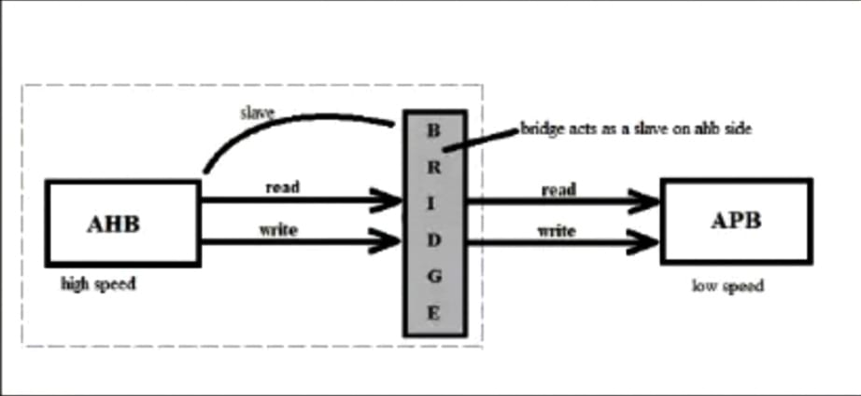
AHB to APB BRIDGE
AHB to APB Bridge Converts the AHB transfers to equivalent APB Transfers.
Bridge provides an Interface between the high speed AHB and low speed APB
Bridge acts will acts as a MASTER as well as SLAVE.
In Master – Slave configuration one master can communicate with only one slave at a time.
In this AHB 2 APB Bridge , AHB Bus will acts as a MASTER and APB will acts a SLAVE.
AHB Master will start the Operations (such as read or write).
When Bridge is interacting with AHB Master , Bridge will acts as a AHB Slave. Because ,Bridge is sampling/receiving the data that sent by the AHB MASTER.

Slide 18
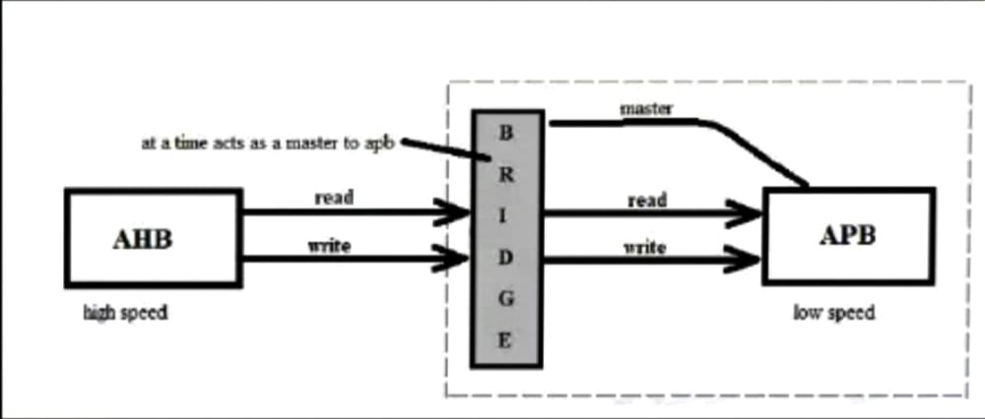
AHB to APB BRIDGE
When Bridge is interacting with APB . It will act as Because APB MASTER to APB Peripherals.
Because Bridge is receiving AHB transfers and converting them to equivalent APB transfers and sending that converted APB transfers to APB Peripherals.
Since APB Peripherals are receiving the data from Bridge, APB Peripherals will act as APB Slave.
Bridge is having its own local Flip Flops, Address decoder and state machine( such as Arbiter Mechanism).
Local Flip flops are , Which latches or store the received data or current information driven by the AHB Master.
Bridge internally having an Address Decoder, which will generate the PSEL signal by decoding HADDR .
PSEL is used to select a one APB peripheral among four APB peripherals.
AHB to APB Bridge is connecting with one AHB MASTER and Four APB SLAVES
Number of AHB MASTER’s = 1
Number of APB SLAVE’s = 4
Bridge can insert wait states to AHB Master . Whenever wait state is inserted the AHB Master has to wait for the APB to complete the Current Transfer.
In order to verify the bridge we have to perform WRITE and READ Operation through Bridge.

Slide 19
AHB to APB BRIDGE
WRITE OPERATION
For Write transfer, the respective control signals HWRITE and PWRITE should be high throughout the write transfer.
In Write transfer, the data will be driven by the AHB Master to Bridge , which will act as a AHB Slave and APB slaved peripherals has to Sample the driven data through Bridge which will act as APB Master.
The AHB Master will drive the HADDR and HWRITE=1 in Address Phase, when HREADYOUT is High(Bridge is ready) .
In next cycle ( such as Data Phase) , AHB Master will drive HWDATA. And HADDR and HWRITE will be latched by local flip flops.
Then , APB Peripherals will receive the HADDR as PADDR , HWRITE as PWRITE and HWDATA as PWDATA in set up state which will generated by the Bridge .
PADDR, PWDATA and PWRITE will be available at the same time at APB Peripheral sides.
AHB Master has to wait for the transfer to be completed by the APB Peripherals by inserting wait state making HREADYOUT to low (HREADYOUT=0).
Whenever PENABLE goes high , the APB Peripherals samples the PWDATA and completes the transfer.

Slide 20
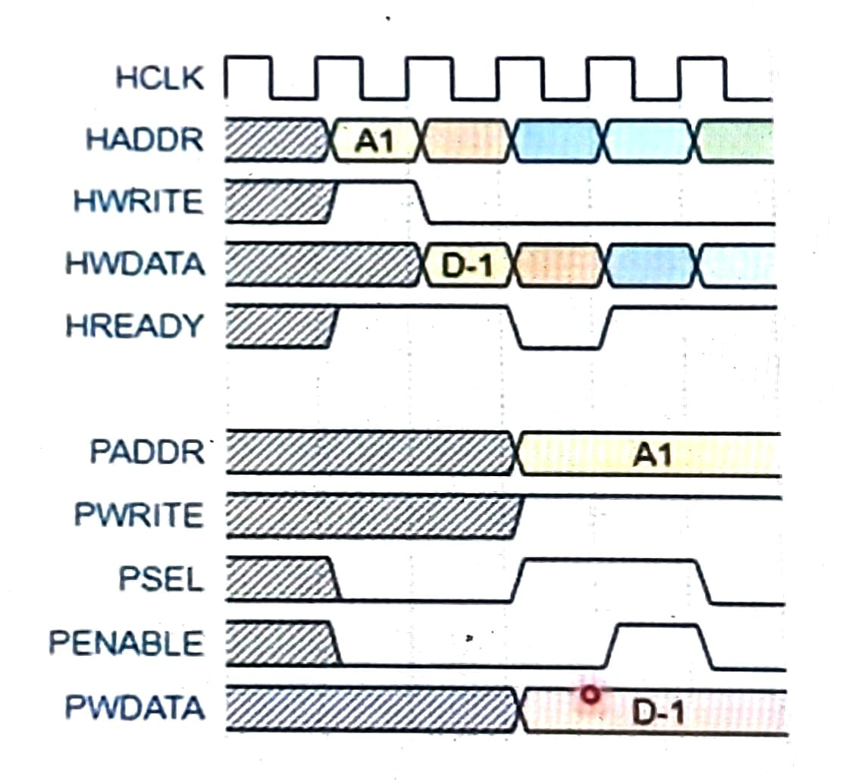
SINGLE WRITE TRANSFER

Slide 21
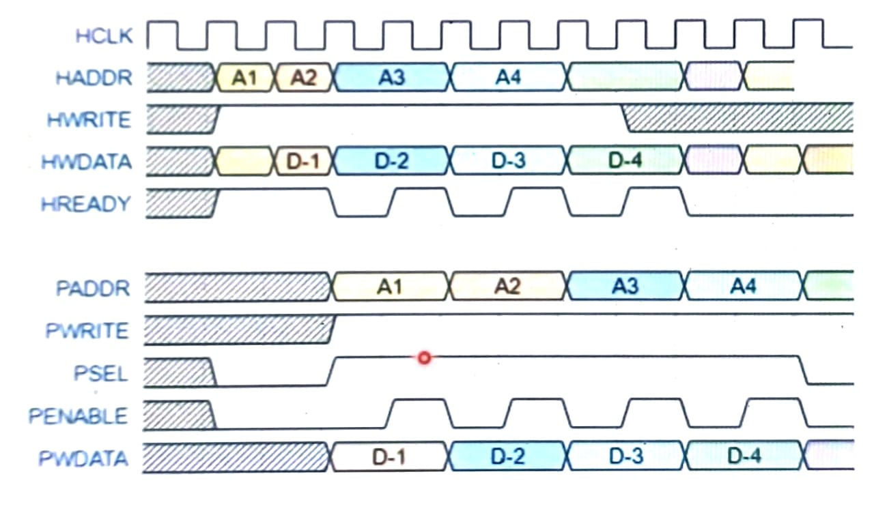
BURST OF WRITE TRANSFERS

Slide 22
AHB to APB BRIDGE
READ OPERATION
For Read Transfer also AHB Master initiates the transfer by driving the HADDR and HWRITE=0 , When Bridge is ready to sample the driven data (HREADYOUT=1).
Since ,it is a read transfer, AHB Master is interested in reading data from APB Slave.
Then, the APB Peripheral Bus get the HWRITE as PWRITE and HADDR as PADDR form the bridge when PSEL !=0.(represents set up state).
Now AHB Master has to wait for the PRDATA by inserting wait state (HREADYOUT=0).
After SET UP state, PENABLE=1 ,that represents ENABLE state. In ENABLE state , APB Peripheral drives the PRDATA at the posedge of the clock.
In the same bus cycle, PRDATA will be received by the AHB Master as HRDATA.
For Read transfer the control signals HWRITE and PWRITE should be low
HWRITE =0
PWRITE =0

Slide 23
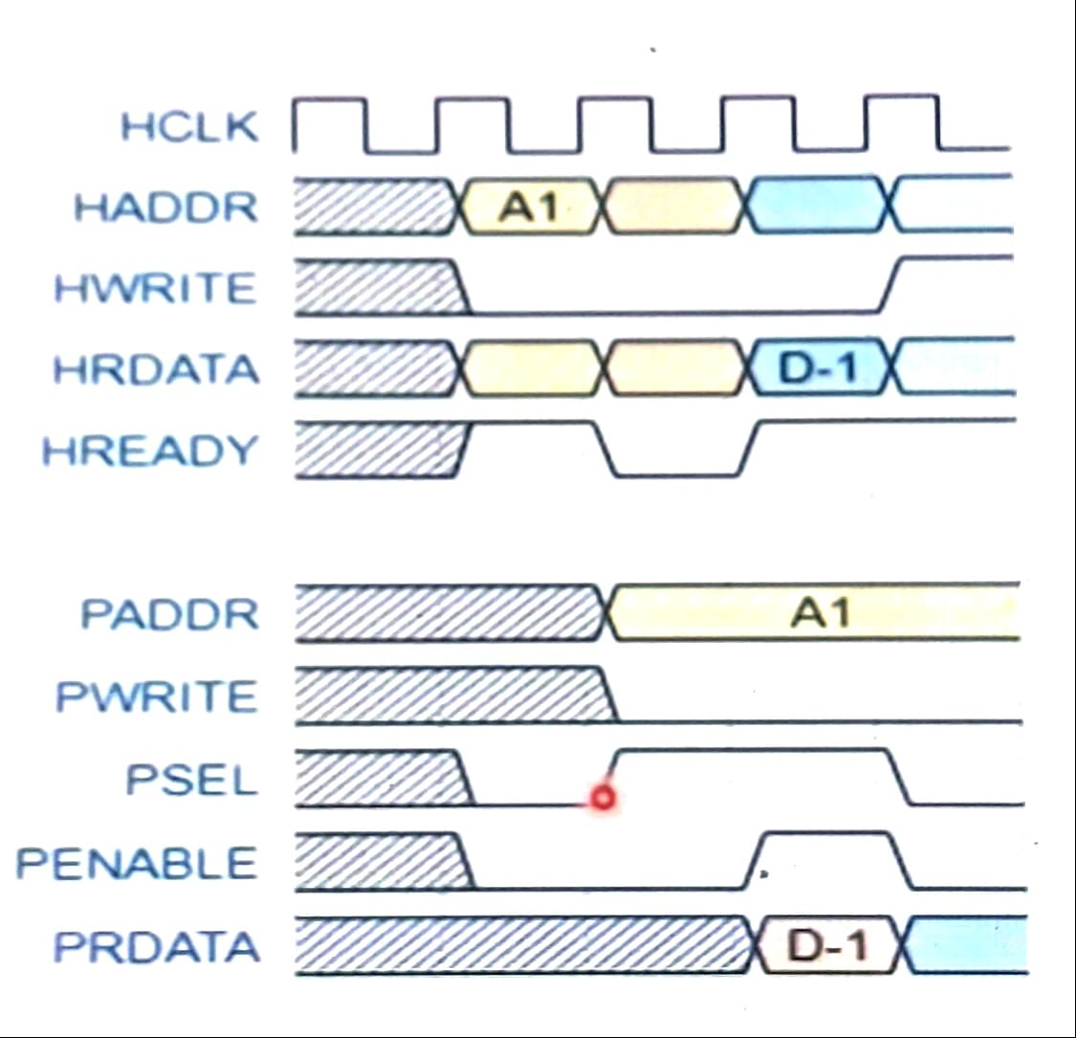
SINGLE READ TRANSFER

Slide 24
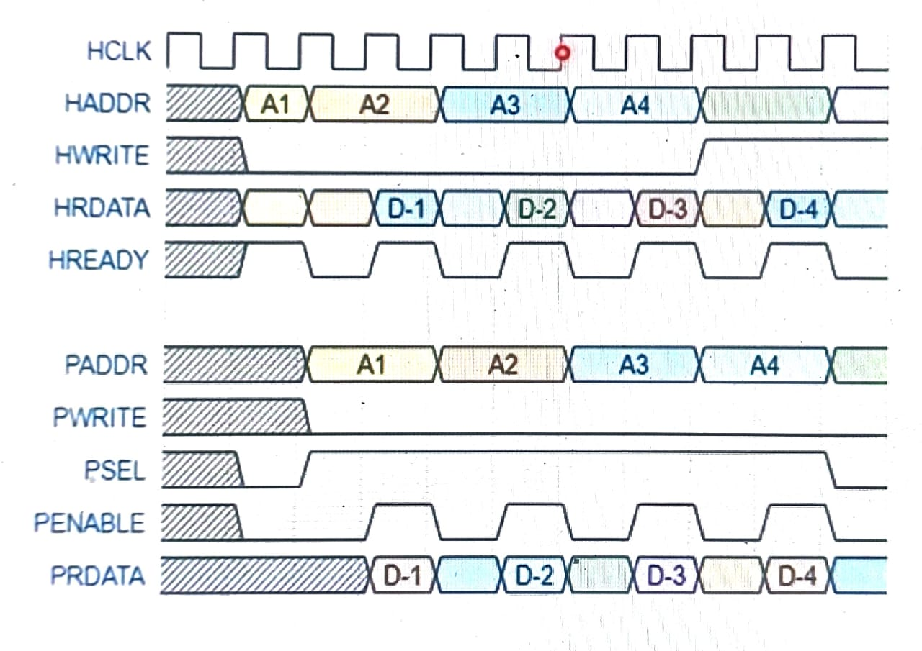
BURST OF READ TRANSFERS

Slide 25
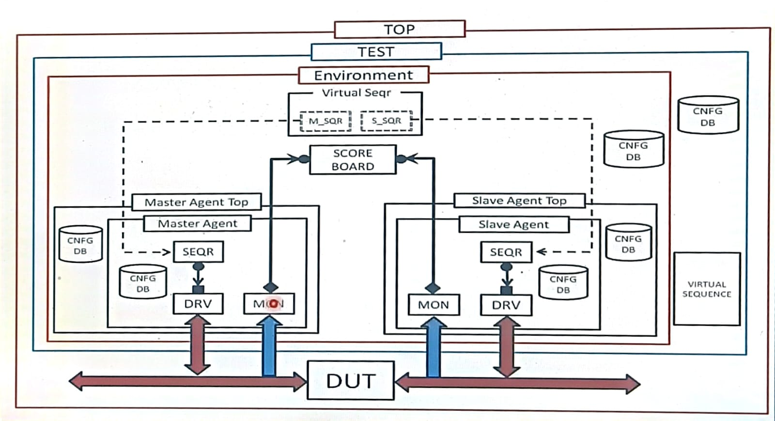
UVM TB Architecture ( to verify AHB 2 APB Bridge)

Slide 26
TB Architecture
To Verify this AHB 2 APB Bridge , We must develop UVM Methodology based TEST BENCH .
Here Test Bench Architecture is having two AGENTS.
1. MASTER AGENT (AHB Master)
2. SLAVE AGENT ( APB Slave)
Both AGENTs will be active agents. All the AHB signals driven by the Master agent and all the APB signals will driven by the Slave agent.
MASTER AGENT will sample the HRDATA ,HWDATA and HADDR.
SLAVE AGENT will sample the PWDATA ,PRDATA and PADDR.
Now in Scoreboard, implemented the Comparison logic to compare the
1. PWDATA with HWDATA
2. PRDATA with HRDATA
3. PADDR with HADDR

Slide 27


